Slide 1
Risk Management Training
''Fail to plan is planning to fail''

Slide 2
Risk Management Process
Risk Management Plan
Identify Risks
Perform Qualitative Risk Analysis
Perform Quantitative Risk Analysis
Plan Risk Responses
Control Risks

Slide 3
Risk Management Plan
Who will do what?
How will we categorize the risks?
How will we report and track the risks?
Budget / Timing

Slide 4
Risk Categories
External, Internal, Technical, Unforeseeable
Risk Dimensions: User, Requirements, Project Complexity, Planning & Control, Team, Organizational Environment
Sources of risk: Schedule, Cost, Quality, Scope, Resources, Customer Satisfaction

Slide 5
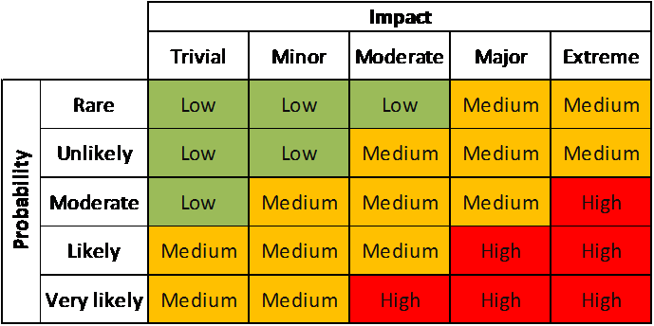
Identify Risks: Qualitative Analysis

Slide 6
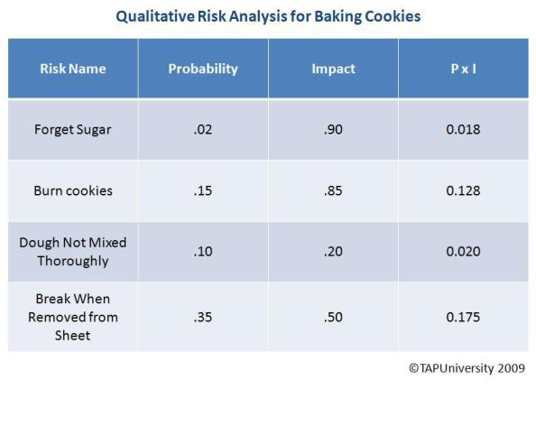
Risk Analysis for Baking Cookies

Slide 7
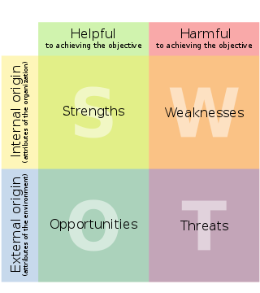
Identify Risks: SWOT Analysis

Slide 8
Risks Responses (mitigation)
What are we going to do about each top risk?
How can we reduce the probability and impact?
Can we do something do eliminate the risk before it happens?
Contingency plan

Slide 9
Risk Control
Monitor the risks
Are they any new risks? -> analyse and plan
Are the risk management processes working?
Update risk status

Slide 10
Exercise 1
Divide in teams and work together to identify risks, mitigation and contingency plan for a fictitious project

Slide 11
Exercise 2
Review the List of Common Risks in Projects, identify which ones would typical apply on TTV and think on mitigation actions

